Slide 1
STATISTICAL QUALITY CONTROL
ME 513

Slide 2
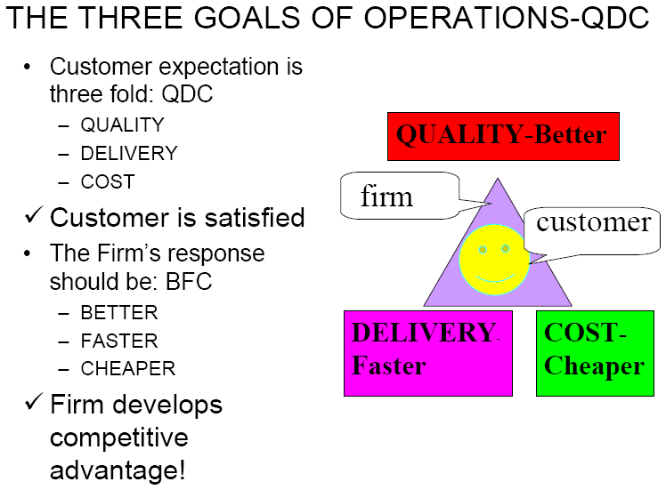

Slide 3
DIFINITION OF QUALITY
The concept and vocabulary of quality are elusive. Different people interpret quality differently. Few can define quality in measurable terms that can be proved operationalized. When asked what differentiates their product or service;
The banker will answer” service”
The healthcare worker will answer “quality health care”
The hotel employee will answer “customer satisfaction”
The manufacturer will simply answer “quality product”

Slide 4
Five Approaches of Defining Quality
Harvard professor David Garvin, in his book Managing Quality summarized five principal approaches to define quality.
Transcendent
Product based
User based
Manufacturing based
Value based

Slide 5
Transcendental view
Those who hold the transcendental view would say “I can’t define it, but I know it when I see it”
Advertisers are fond of promoting products in these terms.
“ Where shopping is a pleasure” (supermarket). “We love to fly and it shows" (airline).
Television and print media are awash with such indefinable claims and therein lies the problem:
Quality is difficult to define or to operationalize. It thus becomes elusive when using the approach as basis for competitive advantage. Moreover, the functions of design, production and service may find it difficult to use the definition as a basis for quality management.

Slide 6
PRODUCT BASED
Quality is viewed as a quantifiable or measurable characteristic or attribute. For example durability or reliability can be measured and the engineer can design to that benchmark.
Quality is determined objectively.
Although this approach has many benefits, it has limitation as well. Where quality is based on individual taste or preference, the benchmark for measurement may be misleading.

Slide 7
USER BASED
It is based on idea that quality is an individual matter and products that best satisfy their preferences are those with the highest quality. This is rational approach but leads to two problems;
Consumer preference vary widely and it is difficult to aggregate these preferences into products with wide appeal. This leads to the choice between a niche strategy or a market aggregation approach which tries to identify those product attributes that meet the needs of the largest number of consumers.
Another problem concerns the answer to the question “Are quality and customer satisfaction the same?” the answer is probably not. One may admit that a Lincoln continental has many quality attribute, but satisfaction may be better achieved with an Escort.

Slide 8
MANUFACTURING BASED
Manufacturing-based definitions are concerned primarily with engineering and manufacturing practices and use the universal definition of “conformance to requirements”. Requirements or specifications are established by design and any deviation implies a reduction in quality. The concept applies to services as well as product. Excellence in quality is not necessarily in the eye of the beholder but rather in the standards set by the organization.
This approach has the serious weakness. The consumer’s perception of quality is equated with conformance and hence is internally focused.

Slide 9
Value Based
It is defined in term of costs and prices as well as number of other attributes. Thus, the consumer’s purchased decision is based on quality at an acceptable price. This approach is reflected in the popular Consumer Reports magazine which ranks products and services based on two criteria: Quality and Value.
The highest quality is not usually the best value. That designation is assigned to the “best- buy” product or service.

Slide 10
The dimensions of quality
Performance
Features
Conformance
Reliability
Durability
Service
Response
Aesthetics
Reputation
QUALITY CHARACTERISTICS
Physical
Sensory
Time orientation

Slide 11
Key Dimensions of Quality
Performance
Features
Reliability
Conformance
Durability
Serviceability
Aesthetics
Perceived quality
Value
Notes:
7

Slide 12
Defining Quality
The totality of features and characteristics of a product or service that bears on its ability to satisfy stated or implied needs
American Society for Quality

Slide 13
Quality – Fitness for use
Q = P/E
Q = QUALITY
P = PERFORMANCE
E = EXPECTATIONS

Slide 14
Quality of Conformance
Quality of Design
Intentional levels or grades of quality.
How well the product conforms to specifications and tolerances required by design.
Quality Engineering
Operational, Managerial and Engineering activities that a company uses to ensure that the quality characteristics are at the nominal or required levels.

Slide 15
Variability
No two products are identical
If variation is large product may be unacceptable
materials, operators, equipments may lead to
variability
Quality Improvement
Reduction of variability in processes and products
Since variation can only be described in statistical terms, statistical methods are of considerable use in quality improvement efforts

Slide 16
Quality improvement as business strategy
Strong consumer quality-performance orientation
Product liability
Increasing cost pressures on labour, energy and
raw materials
More intensive competition
Dramatic improvements in productivity through
quality engineering programmes

Slide 17
Two Ways Quality Improves Profitability
Sales Gains via
Improved response
Flexible pricing
Improved reputation
Improved Quality
Increased Profits
Reduced Costs via
Increased productivity
Lower rework and scrap costs
Lower warranty costs
Figure 6.1

Slide 18
Costs of Quality
Prevention costs - reducing the potential for defects
Appraisal costs - evaluating products, parts, and services
Internal failure - producing defective parts or service before delivery
External costs - defects discovered after delivery

Slide 19
Prevention costs
Quality planning and engineering
New products reviews
Product/ process design
Process control
Burn – in : Preshipment to prevent early failures
Training
Quality data acquisition and analysis

Slide 20
Appraisal costs
Inspection and test of incoming material
Product Inspection and test
Materials and services consumed – consumed in reliability tests, devalued by reliability tests
Maintaining accuracy of test equipment

Slide 21
Internal failure costs
Scrap
Rework
Retest
Failure Analysis
Downtime
Yield losses
Downgrading/ off - specing

Slide 22
External Failure costs
Component adjustment
Returned product/ material
Warranty charges
Liability costs – including litigation
Indirect costs – reputation, future business

Slide 23
Costs of Quality
Total Cost
Total Cost
External Failure
Internal Failure
Prevention
Appraisal
Quality Improvement

Slide 24
Ethics and Quality Management
Operations managers must deliver healthy, safe, quality products and services
Poor quality risks injuries, lawsuits, recalls, and regulation
Organizations are judged by how they respond to problems
All stakeholders must be considered

Slide 25
Methods of Quality Improvement
Acceptance sampling
Statistical Process Control
Design of Experiments
Zero defects program
Quality Circle programme

Slide 26
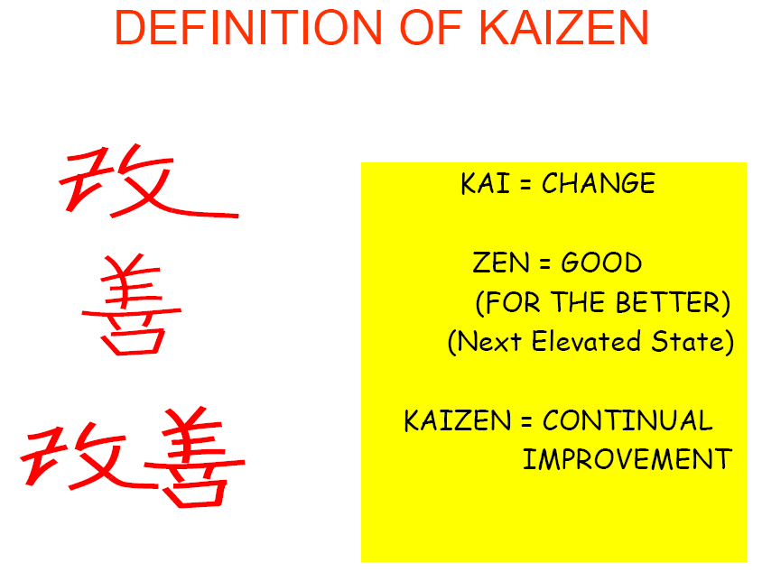

Slide 27
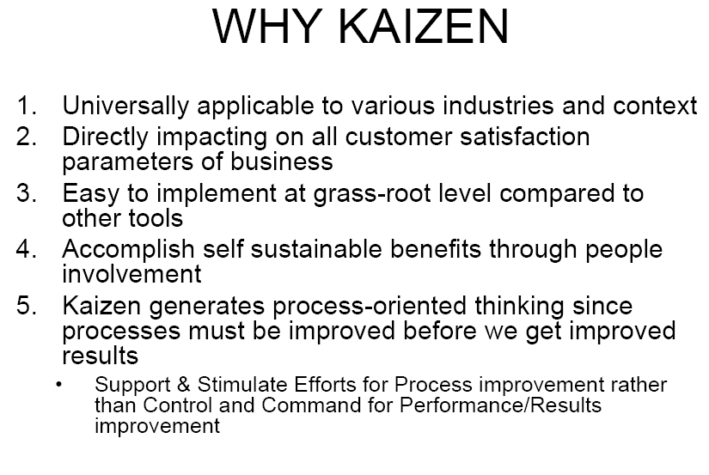

Slide 28
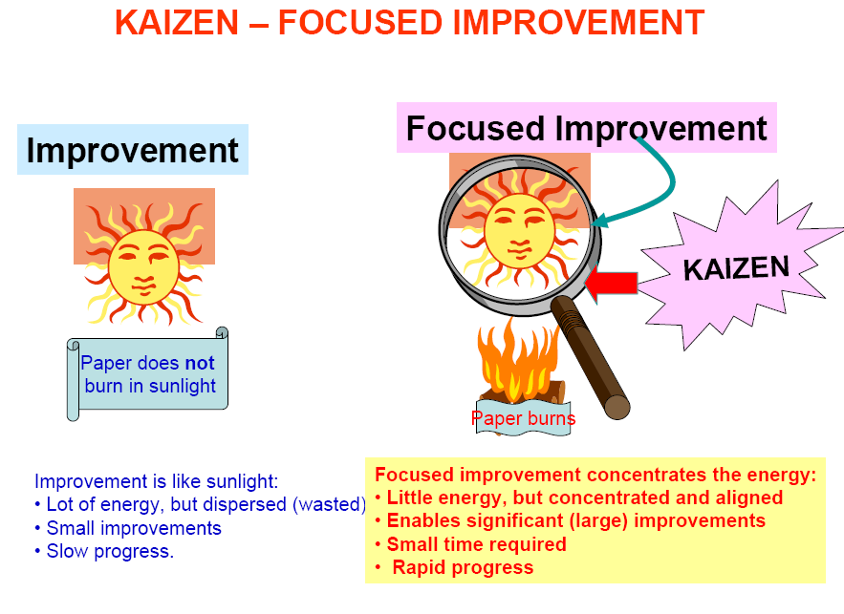

Slide 29
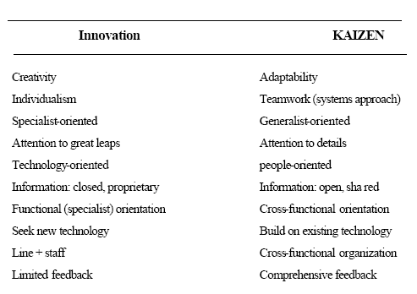

Slide 30
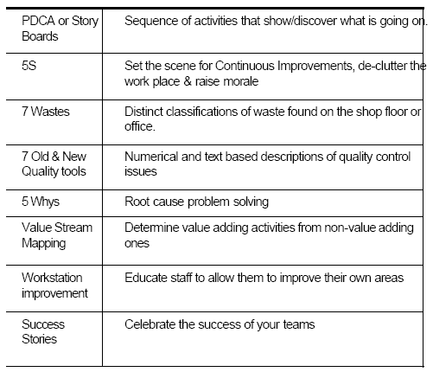

Slide 31
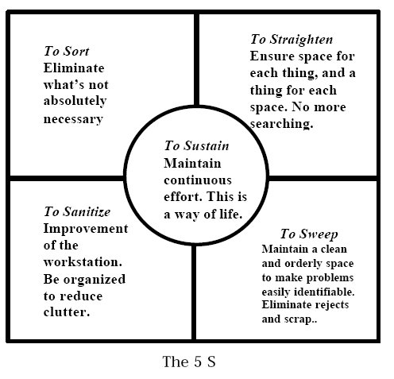

Slide 32
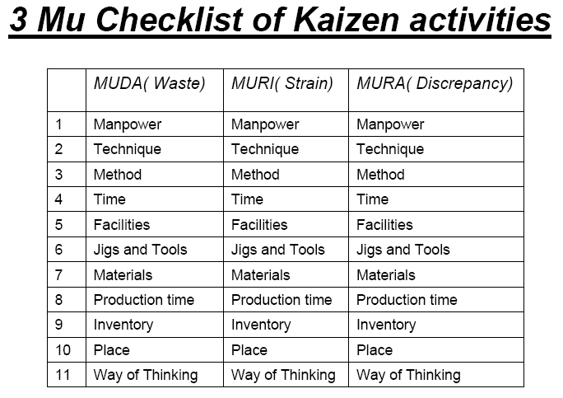

Slide 33
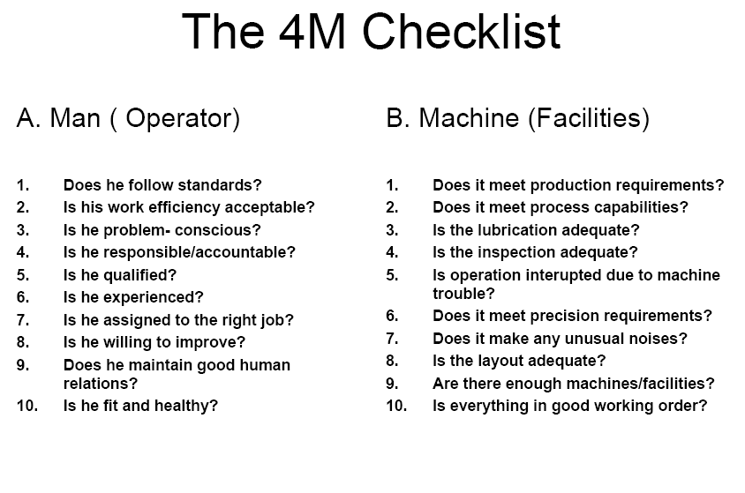

Slide 34
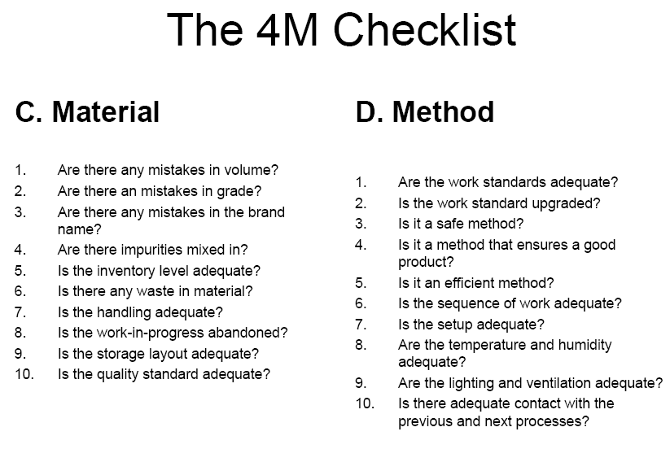

Slide 35
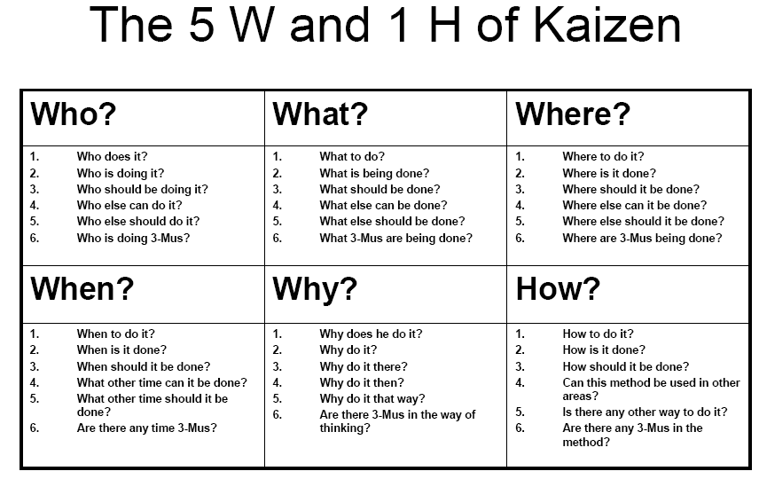

Slide 36
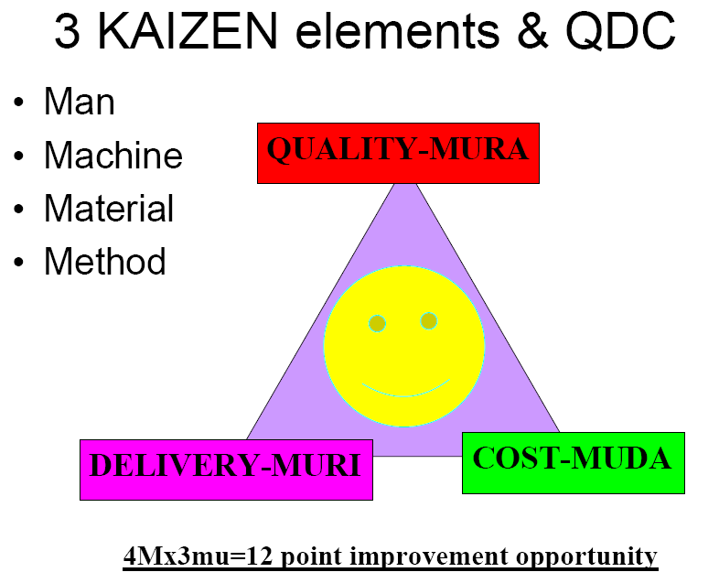

Slide 37
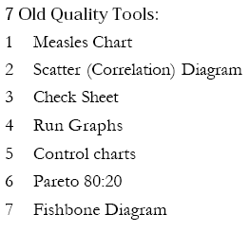

Slide 38
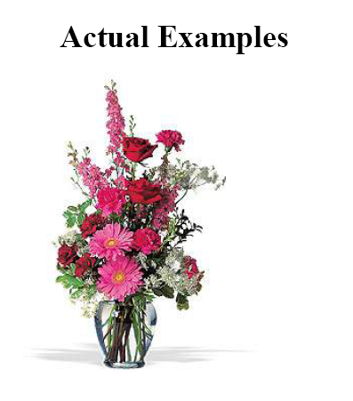

Slide 39
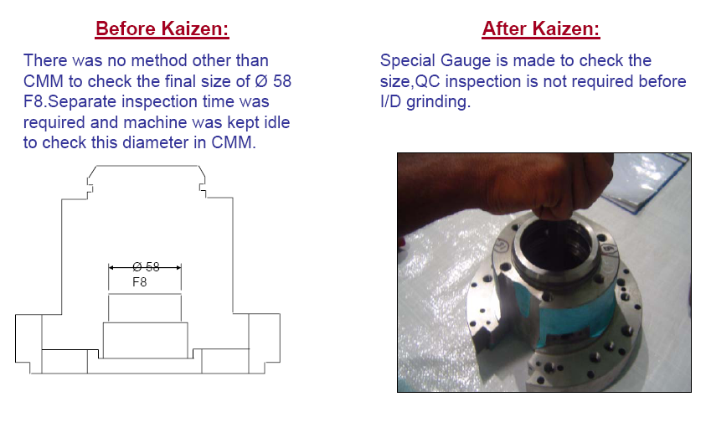

Slide 40
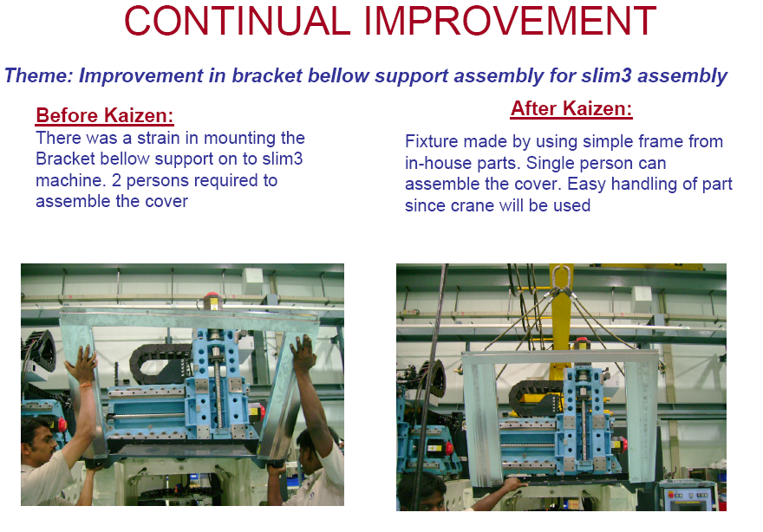

Slide 41
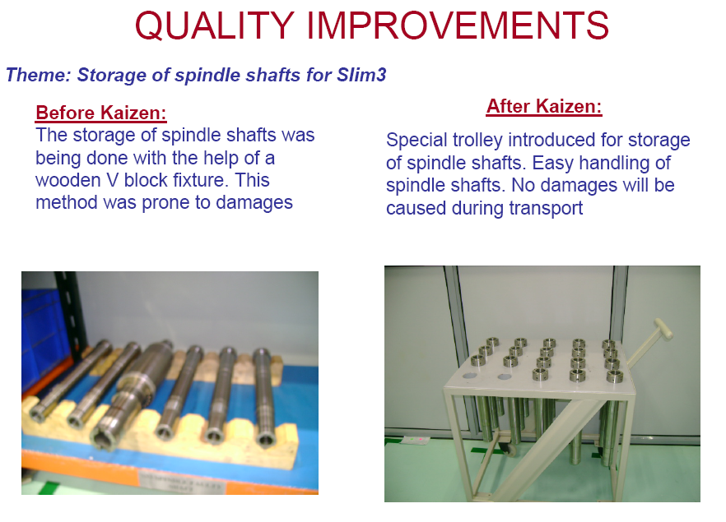

Slide 42
Tools of TQM
Tools for Generating Ideas
Check sheets
Scatter diagrams
Cause-and-effect diagrams
Tools to Organize the Data
Pareto charts
Flowcharts

Slide 43
Tools of TQM
Tools for Identifying Problems
Histogram
Statistical process control chart

Slide 44
Seven Tools of TQM
(a) Check Sheet: An organized method of recording data
/
/
/ / /// /
// ///
// ////
///
//
/
Hour
Defect 1 2 3 4 5 6 7 8
A
B
C
/
/
//
/
Figure 6.6

Slide 45
Seven Tools of TQM
(b) Scatter Diagram: A graph of the value of one variable vs. another variable
Productivity
Absenteeism
Figure 6.6

Slide 46
Seven Tools of TQM
(c) Cause-and-Effect Diagram: A tool that identifies process elements (causes) that might effect an outcome
Cause
Materials
Methods
Effect
Manpower
Machinery
Figure 6.6

Slide 47
Seven Tools of TQM
(d) Pareto Chart: A graph to identify and plot problems or defects in descending order of frequency
Frequency
Percent
A B C D E
Figure 6.6

Slide 48
Seven Tools of TQM
(e) Flowchart (Process Diagram): A chart that describes the steps in a process
Figure 6.6

Slide 49
Seven Tools of TQM
(f) Histogram: A distribution showing the frequency of occurrences of a variable
Distribution
Frequency
Repair time (minutes)
Figure 6.6

Slide 50
Seven Tools of TQM
(g) Statistical Process Control Chart: A chart with time on the horizontal axis to plot values of a statistic
Upper control limit
Target value
Lower control limit
Time
Figure 6.6

Slide 51
Cause-and-Effect Diagrams
Material
(ball)
Method
(shooting process)
Grain/Feel (grip)
Aiming point
Size of ball
Bend knees
Air pressure
Hand position
Lopsidedness
Balance
Follow-through
Missed free-throws
Training
Rim size
Conditioning
Motivation
Rim height
Consistency
Rim alignment
Backboard stability
Concentration
Manpower
(shooter)
Machine
(hoop &
backboard)
Figure 6.7

Slide 52
Pareto Charts
Data for October
70 –
60 –
50 –
40 –
30 –
20 –
10 –
0 –
– 100
– 93
– 88
– 72
54
Frequency (number)
Number of occurrences
Cumulative percent
12
4
3
2
Room svc Check-in Pool hours Minibar Misc.
72% 16% 5% 4% 3%
Causes and percent of the total

Slide 53
Flow Charts
MRI Flowchart
Physician schedules MRI
Patient taken to MRI
Patient signs in
Patient is prepped
Technician carries out MRI
Technician inspects film
If unsatisfactory, repeat
Patient taken back to room
MRI read by radiologist
MRI report transferred to physician
Patient and physician discuss
8
80%
1
2
3
4
5
6
7
11
9
10
20%

Slide 54
Statistical Process Control (SPC)
Uses statistics and control charts to tell when to take corrective action
Drives process improvement
Four key steps
Measure the process
When a change is indicated, find the assignable cause
Eliminate or incorporate the cause
Restart the revised process

Slide 55
An SPC Chart
Plots the percent of free throws missed
20%
10%
0%
Upper control limit
Coach’s target value
| | | | | | | | |
1 2 3 4 5 6 7 8 9
Lower control limit
Game number
Figure 6.8

Slide 56
Quality Circles
By : Terri Spahr

Slide 57
Overview
What are Quality Circles?
How Do Quality Circles Work?
How Can They be Used in an Organization?
Example and Activity
Problems with Quality Circles
Summary of History and Practices
Bibliography
Notes:
Overview of the Presentation content.

Slide 58
What is a Quality Circle?
Voluntary groups of employees who work on similar tasks or share an area of responsibility
They agree to meet on a regular basis to discuss & solve problems related to work.
They operate on the principle that employee participation in decision-making and problem-solving improves the quality of work
Notes:
Number of members ranging from 3-12 people.
They focus on specific issues to resolve problems.
They generally meet weekly to analyze work related problems and propose solutions to Management and where possible implement those solutions.
Members also tend to generate a mutual respect and trust as they work on solutions, which is conducive for collaborating as a team.

Slide 59
How Do Quality Circles Work?
Characteristics
Volunteers
Set Rules and Priorities
Decisions made by Consensus
Use of organized approaches to Problem-Solving
Notes:
Participation in Quality Circles needs to strictly be voluntary. If members are forced to participate, it does not allow for a conducive team building environment.
The members of the Quality Circle set the rules and prioritizes/selects problems that will be approached and discussed by the team.
All decisions are made by consensus, encouraging open communication.
Organized problem-solving should be utilized, which would include brainstorming and cause-and-effect diagramming. This organized approach also prevents the circles from holding unproductive sessions as well.

Slide 60
How Do Quality Circles Work?
All members of a Circle need to receive training
Members need to be empowered
Members need to have the support of Senior Management
Notes:
Ishikawa, when developing this concept always believed that everybody should be properly trained to use the 7 Tools of Quality Control:
1. Pareto Charts
2. Cause and Effect Diagrams
3. Stratification
4. Check Sheets
5. Histograms
6. Scatter Diagrams
7. Control Charts and Graphs
He also believed that the circles should be empowered enough to see their recommendations through. Along with empowerment, it is expected to have management support. Many times Circles have collapsed due management lack of interest or interference.

Slide 61
How Can They be Used in an Organization?
Increase Productivity
Improve Quality
Boost Employee Morale
Notes:
Quality Circles can be used in any organization, whether it is Manufacturing, Service, Health Care, Education, etc.
They can be used to increase productivity…as an example, members can develop ways to decrease lead times for products.
They can be used to help improve quality of services as well as products. If there are issues, members can analyze the process and come up with solutions to make it better. This will improve quality and likely increase productivity as well.

Slide 62
